Slide 1



MID REVIEW
Balasubramanian R SJMSOM, IIT Bombay

Slide 2
1
2
AGENDA
3
4
LEARNINGS
SELECTION GAP
A brief overview of learnings in the 3 weeks
Detailed presentation of the progress on the deliverable
ASANA
OTB FOR ELCA
Importance & Implementation
Learning and adaptation

Slide 3
LEARNINGS
Understanding Category Planning
Gained insights into the strategic role of category planning in retail-specific to beauty products, focusing on optimizing product assortments and maximizing profitability (both on buy and sell side)
Dynamics of the Processes
Gained an understanding of the inter-connected nature of teams like Planning, B&M and Finance, by being a shadow participant in various team meetings leading to a gain of business side perspective
Importance of Planning
Understood that effective planning ensures that decisions are aligned with business objectives directly impacting Tira's operational efficiency
Hands-on Experience
Directly involved in creating and replicating the replenishment file for offline stores for the month of May’24 leading to a gain of practical insights into various similar processes like OTB, etc

Slide 4
REPLENISHMENT FOR OFFLINE STORES
Learnings from the Process
Process Improvement Suggestion
Data Integrity
Ensured accuracy in data inputs from start to end thereby preventing costly errors in inventory forecasts
Formula Application and Replication
Understood and adapted replenishment calculations from the previous file to align and allow for precise adjustments while simultaneously learning the process
Understanding of Key Concepts
Deepened understanding of critical inventory management metrics and their application in practical settings, facilitating smarter, data-driven decision-making for store replenishments
Visual Basic Macro
Developing an Excel macro to automate the sequence of data manipulation tasks
This would include:
Data Import, Data Transformation and Calculation
Application of formulas across the dataset to calculate DRR and other necessary metrics
Vlookup Implementation Automate the Vlookup function for parameter checks to determine SKU replenishment eligibility

Slide 5


Selection Benchmarking
Command Flow of Selection Benchmarking Python Script
Initial data cleaning and normalization using spaCy for natural language processing
Pre-processing
Transforming processed text into numerical vectors using TfidfVectorizer
Vectorization
Fuzzy Matching
Comparing vectorized text data using Fuzzy Wuzzy to find potential matches
Aggregating and storing match results in a structured format
Results
Click here for the full code

Slide 6
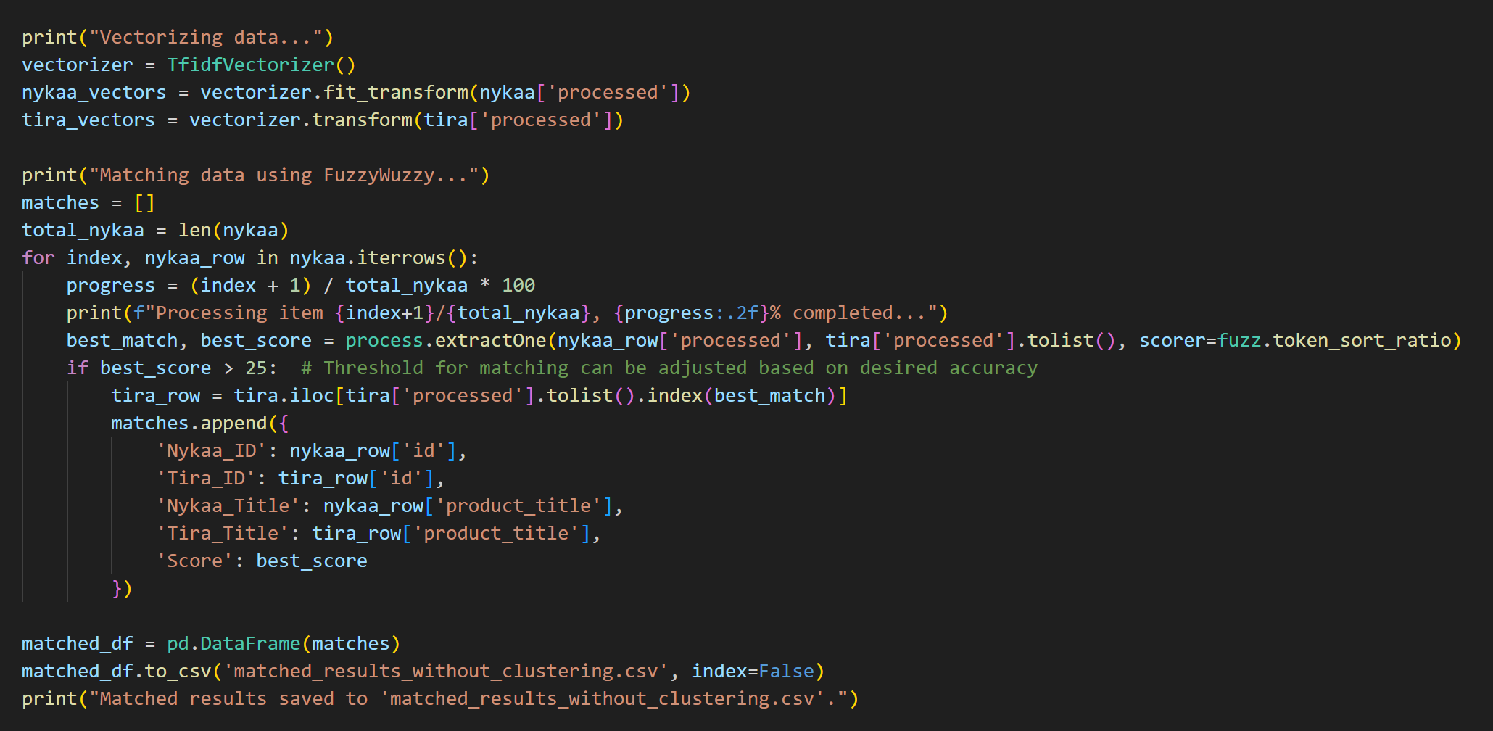
PYTHON SCRIPT FOR BENCHMARKING

Slide 7
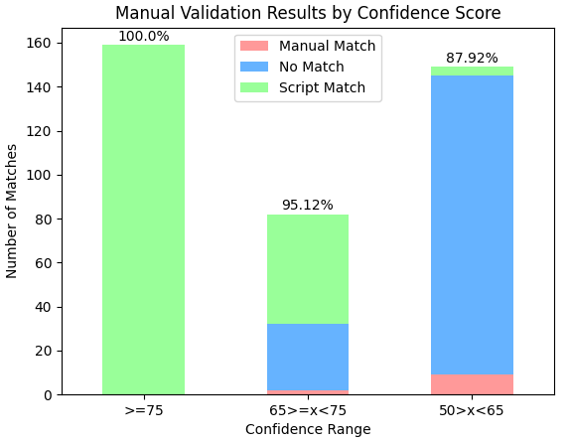

ANALYSIS
Category Level Matches
Best Seller Subset Level Matches
Accuracy Metrics
Best Sellers | 394
Match Type | # Count | # of total
script_match | 213 | 5406%
no_match | 170 | 4315%
manual_match | 11 | 279%
Confidence Range | manual_match | no_match | script_match | Accuracy
>=75 | 0 | 0 | 159 | 10000%
50>x<65 | 9 | 136 | 4 | 8792%
65>=x<75 | 2 | 30 | 50 | 9512%
Accuracy in High Confidence (>75) at 100% along with a 95% accuracy at medium confidence range underscores the reliability of the script
Accuracy of the script in co-relation with the manual validation is 9435%

Slide 8
INSIGHTS
High Engagement Products
High Engagement Products
Products with high Nykaa rating counts are also associated with significant booked revenue in Tira, indicating strong cross-platform popularity
This suggests that items highly rated on Nykaa also tend to perform well on Tira, indicating similar customer preferences across both platforms
The categories such as 'skin' and 'bath-body' dominate the high-ranking products in both ratings and revenue indicating strong market demand in these categories
Items like Fiama and Gillette Cartridges in 'bath-body' show a high revenue rank in despite fewer ratings in Nykaa, suggesting lack of competition in these specific niches on Tira
Revenue and Rating Correlation
Opportunities
There is a correlation between high ratings and high revenue in many cases
For instance, the top revenue-generating items in Tira like COSRX (₹5.17 Cr) and Laneige (₹0.37 Cr) also have high rating counts, suggesting that well-received products tend to generate significant sales
There were 64 bestsellers in Nykaa that matched but had no sales data and/or zero revenue in Tira
Deep diving into it’s observed that the product is either out of stock or delisted from the website

Slide 9
INSIGHTS
Rating Count (Nykaa)
Average: 5,859 reviews per product
Median: 904 reviews per product
Range: From 11 to 95,610 reviews
Initial Descriptive Insights
Variance in Ratings and Revenue:
There's a significant variation in both ratings and revenue across products. Some products are highly rated but might not correspondingly generate high revenue on Tira, indicating potential mismatches in customer engagement versus sales conversion
Disparity Between Average and Median
The large difference between the average and median values, especially in revenue, suggests the presence of outliers – possibly a few products with exceptionally high revenue skewing the average
Tira Booked Revenue
Average: ~ ₹628,356 per product
Median: ₹21,202 per product
Range: ₹46 to ₹51,733,890
High Ratings but Low Revenue
Some products with high ratings on Nykaa might have disproportionately low revenue on Tira, which could indicate issues like pricing, availability, or competitive offerings on Tira
Low Ratings but High Revenue
Conversely, products with fewer ratings but high revenue on Tira might indicate niche products that, despite lower overall customer engagement, are highly profitable or have a dedicated customer base

Slide 10
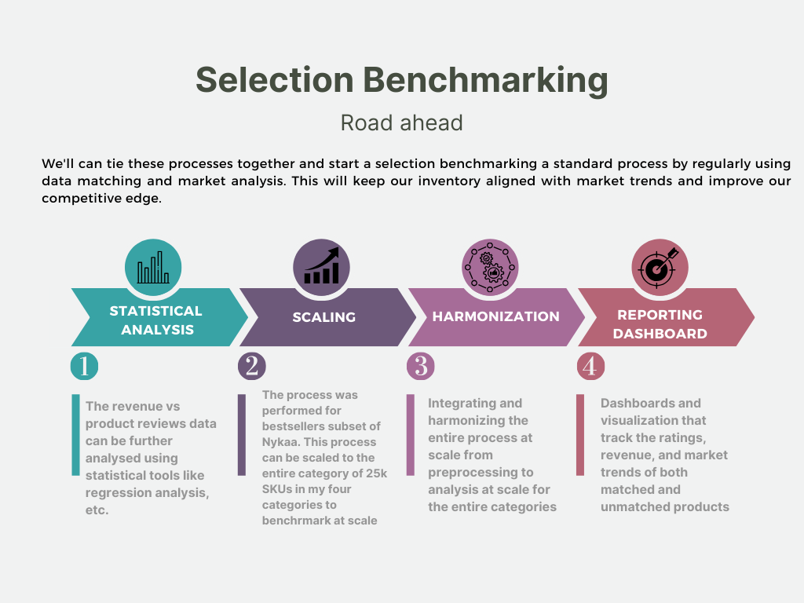
ROAD AHEAD

Slide 11
ASANA
Importance of Asana
Asana streamlines project tracking and communication, ensuring all team members are aligned and accountable This tool allows us to manage tasks effectively, set deadlines, and update statuses in real-time, reducing the need for frequent meetings and email exchanges
Learning and Initial Setup
Completed Asana's essential training modules to understand its capabilities and interface
Set up an Asana workspace specifically tailored for our team, including basic project templates that mirror our current workflows
Integration and Pilot Testing
Will Integrate Asana with essential tools such as One Drive and Teams to streamline our workflows
Initiate a pilot test with tasks of my internship to start adapting to Asana for daily tasks and showcase scalablity

Slide 12
ASANA
Feasibility of Asana
Asana is highly scalable and can be effectively used in an organization like our which is akin to a startup
Its success largely depends on proper onboarding, continual support, and active use of its features to ensure it integrates well with existing systems and workflows
Centralized Platform
Asana provided a central platform for managing a variety of workflows, from product roadmaps to tracking
Visibility and Transparency
HODs can use Asana to track important projects and keep everyone aligned on company goals, significantly enhancing transparency and accountability across departments

Slide 13
Open-To-Buy - IMPORTS
Learning Open to Buy Process
Gained an understanding of the open-to-buy process which is critical in inventory management particularly for imported brands which has a longer lead time
OTB is essentially a financial budget for retail merchandising that helps in planning inventory purchases without overbuying or underbuying
Understand the OTB file
Learned how Booking Revenue sets the initial expectation for sales potential, influenced heavily by market conditions and consumer preferences
Learned correlation between sales forecasts and inventory requirements and how precise adjustments in inventory levels can prevent overstocking or stockouts
The process culminates in understanding Net Revenue and how returns and taxes further adjust our expected income. This ties directly back to how we plan our stock levels (Opening and Closing SOH), ensuring we're equipped to meet anticipated sales without excess expenditure

Slide 14
THANKS!
Do you have any questions?

